Slide 1

Project 1 – Group 9 University of Berkeley Data Analytics 2023
Dianna Stafford
Vanessa Delgado
Senelli Jinadasa
Tina Dehghan
Jasleen Kaur

Slide 2

Overview Summary
Our group has worked on Vision Zero Project from the City of Tempe which was based on data-driven evidence of why there was an increased incident in accidents between the years 2019-2022.
The industry we studied was about Traffic and Public Safety and to best understand how to reduce the severity of injuries and prevent crashes and create public awareness of road safety issues.
We extracted our dataset from Data.gov and we chose it because it had numerical and categorical values which showed correlation in the data. It also provided a good sample size along with coordinates to determine the exact location of the incident.
The collection of the data came from a CSV file and was prepared and cleaned up on Jupyter notebook by removing variables which were not being studied.
We used the Exploratory Data Analysis to study the specific years, age groups, weather conditions, severity of injuries, and influence of alcohol and drugs on crash accidents in the City of Tempe.
The approach that your group took to achieve the project goals was reviewing the dataset together, understanding the association of the variables by studying the article. We used Descriptive Statistical Analysis to measure the mean, median, mode, identifying outliers, and imputing null values.

Slide 3
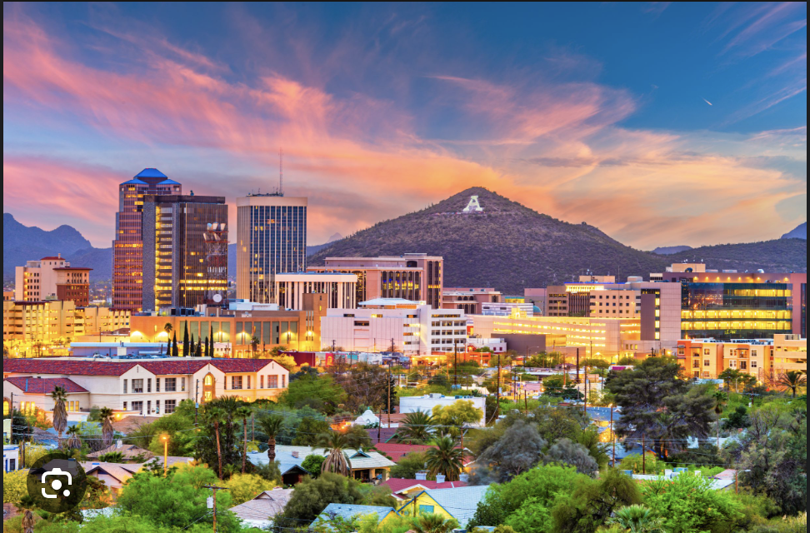
The team did not anticipate that preparing the data would be extremely hard. Understanding and correlating the data was also a big challenge for the team to overcome.
The results/conclusions of the application or analysis was that we were able to determine that there are a lot more young aged drivers between the age groups of 35-37 years.
The dataset reveals a notable increase in the percentage of suspected injuries during the year 2019. It suggests a potential correlation between the pandemic and the frequency of suspected injuries.
This finding indicates a proportionate distribution of suspected injuries among the recorded incidents.

Slide 4

Research Questions
ARIABLESABLES
Dependent: Accidents
Independent: Date and Time; Age; Injuries, Driving under influence of alcohol and drugs
RQ1: Is there an association between a particular date and time when accidents occurred in City of Tempe between 2019-2022?
RQ2: Is there a correlation between age groups and injuries due to accidents in the City of Tempe between 2019-2022?
RQ3: Is there an association between age and driving under the influence of alcohol/drugs when accidents occurred in City of Tempe between 2019-2022?
VARIABLES
4

Slide 5
Hypotheses
RQ 1
H0- There is no association between a particular date and time when accidents occurred in City of Tempe between 2019-2022.
RQ 2
H0- There is no association between age groups and injuries due to accidents in the City of Tempe between 2019-2022.
RQ 3
H0- There is no association between age and driving under the influence of alcohol/drugs when accidents occurred in City of Tempe between 2019-2022.
Ha- There is an association between a particular date and time when accidents occurred in City of Tempe between 2019-2022.
Ha- There is an association between age groups and injuries due to accidents in the City of Tempe between 2019-2022.
Ha- There is an association between age and driving under the influence of alcohol/drugs when accidents occurred in City of Tempe between 2019-2022.
5

Slide 6
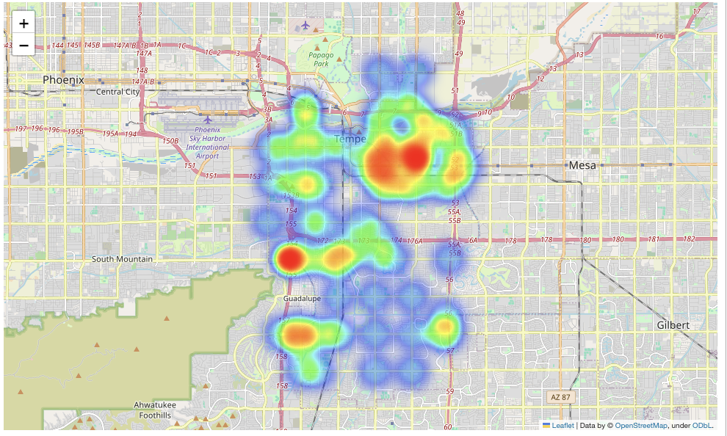
City of Tempe, Arizona
Vision Zero Project
Data-driven approach to reduce crash accidents and increase public safety
Studied between the years 2012-2023
Resources:
Vision Zero Project, Arizona
Arizona Department of Transportation
Crash Data from City of Tempe

Slide 7
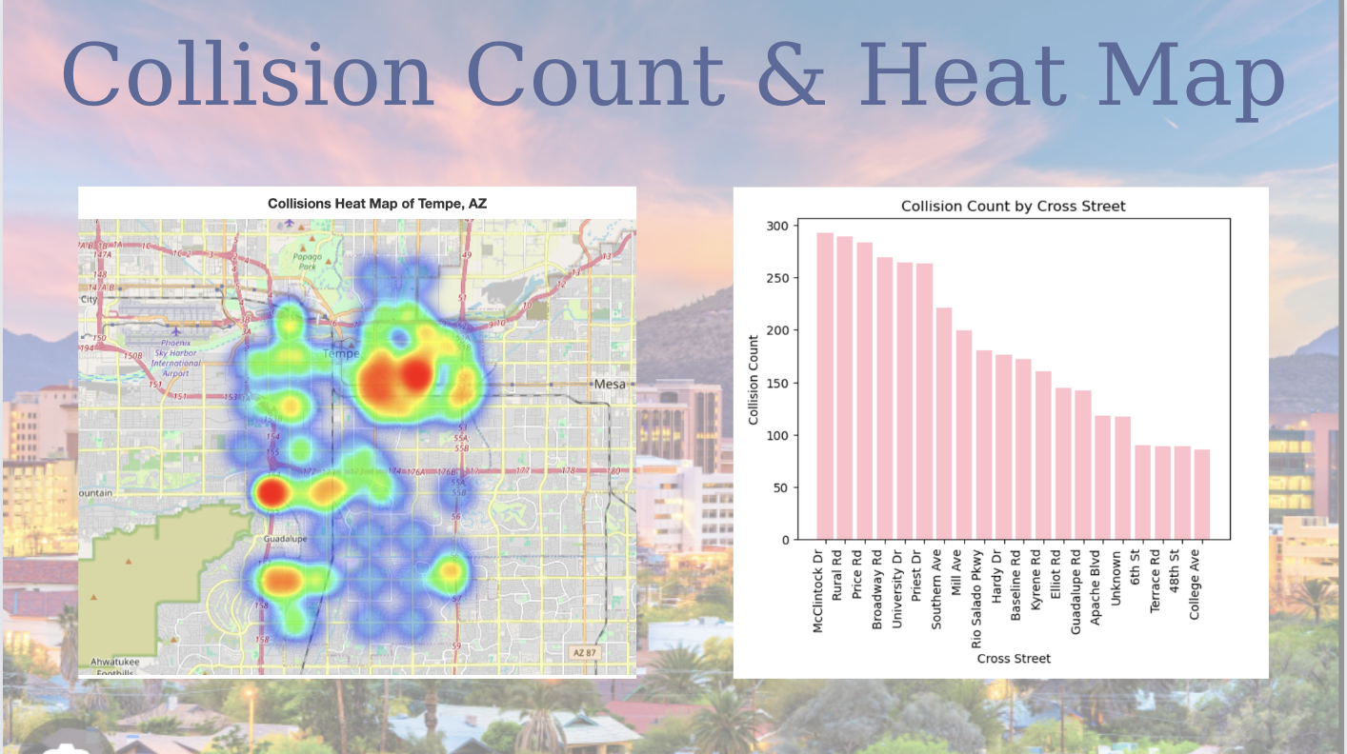

Slide 8
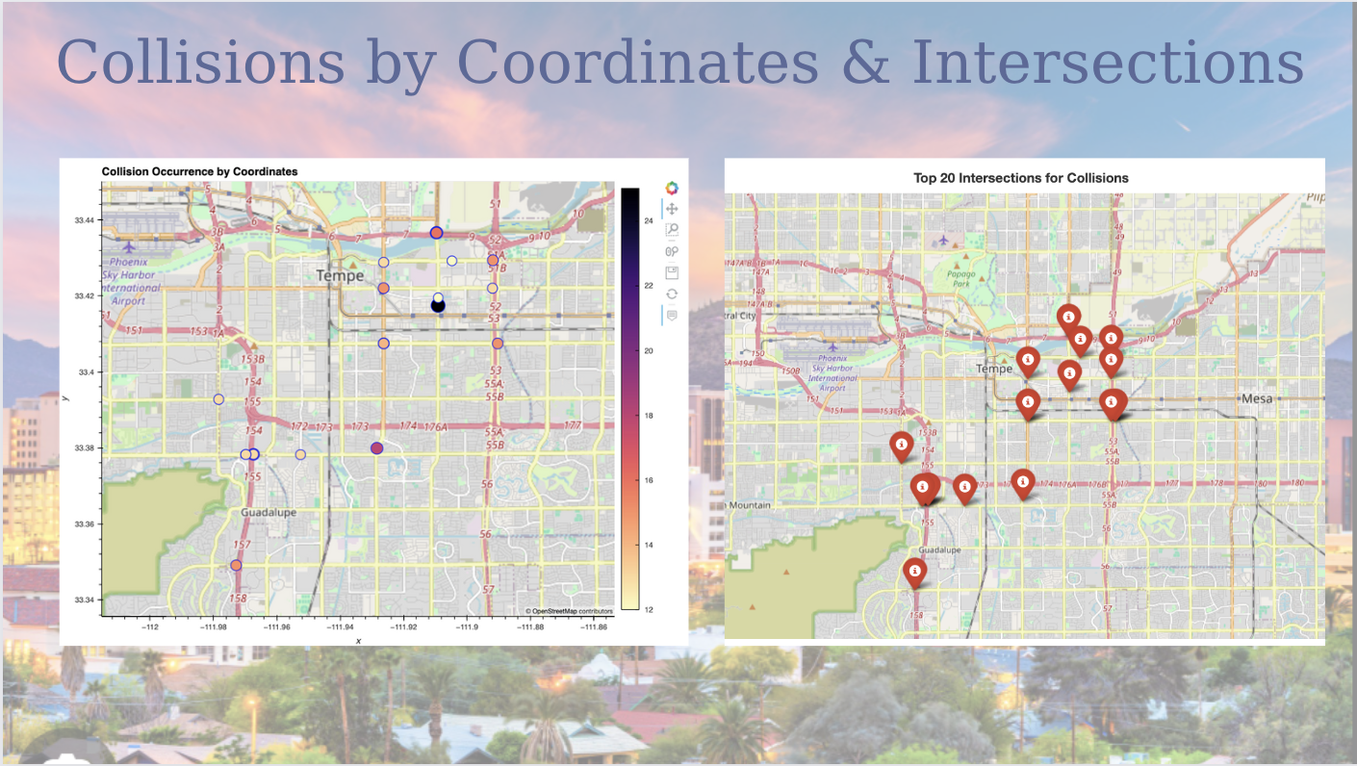

Slide 9
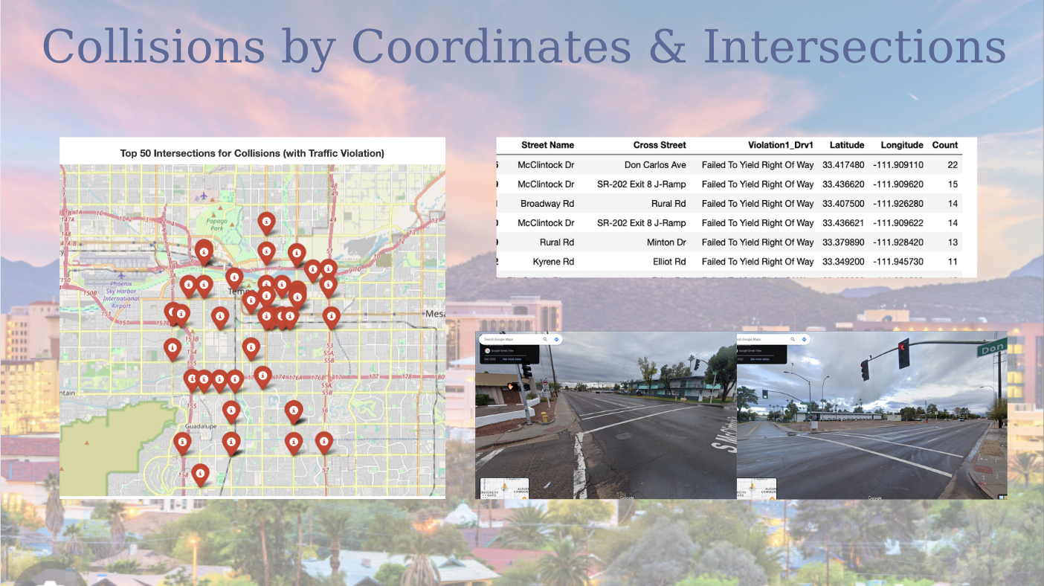

Slide 10
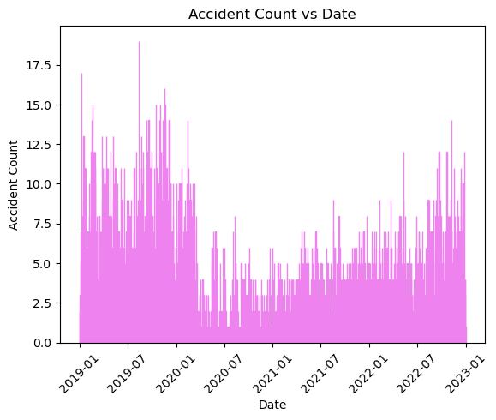
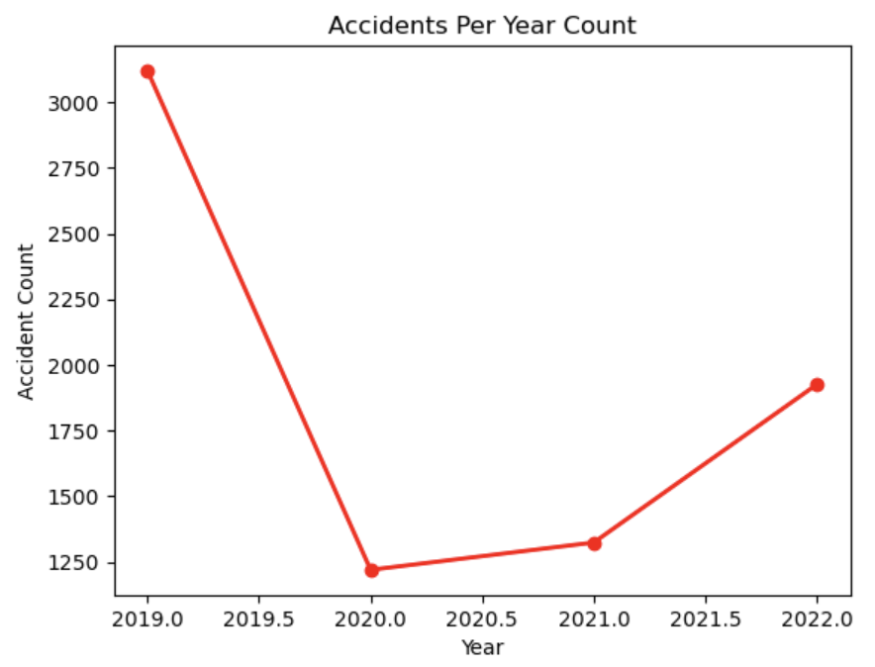
RQ1: Is there an association between a particular date and time when accidents occurred in City of Tempe between 2019-2022?
P-value: 0.107; more than 0.05
There is a significant difference in the “Years” and ”Accident Counts”

Slide 11
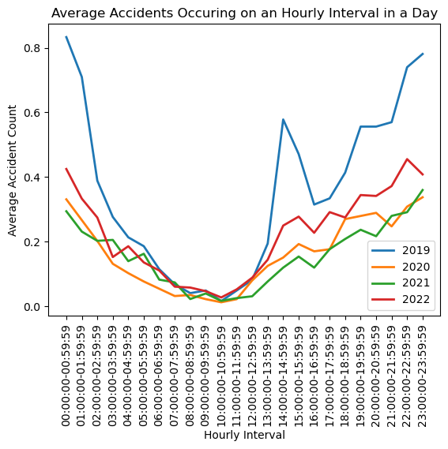
Accident vs. Hourly Interval
Average accidents per hour in a 24- hour period between the years 2019-2022. It can be noted that all years follow a similar trend in accident occurrence.
In 2019, there were higher amounts of accidents that occurred during the 12 am – 4 am and drops significantly between the mid-day and picks back up during the last hours of the day.
In 2020 & 2021, in the pandemic years, there is a significant decrease in the number of accidents.
In 2022, the average amounts of accidents occurring started to peak around the similar times as 2019.

Slide 12
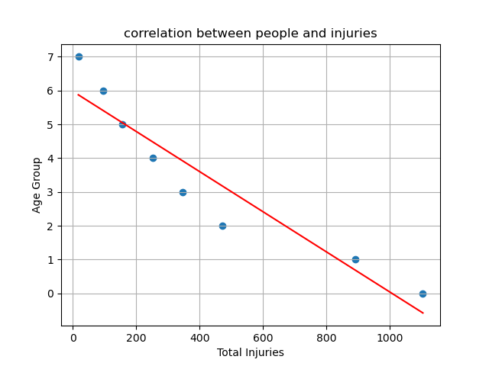
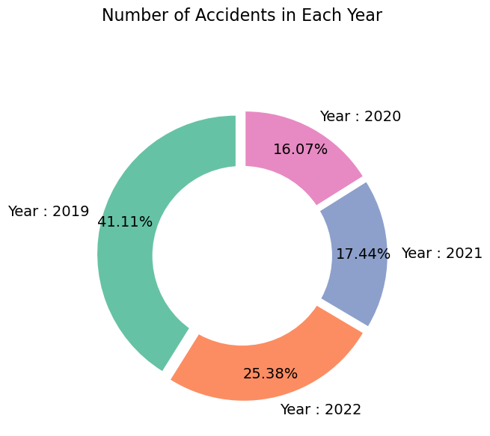
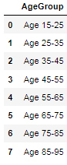
RQ2: Is there a correlation between age groups and injuries due to auto collisions in the City of Tempe between 2019-2022?
The r-squared value is: 0.8923719850266401
The p-value is: 0.0175; less than 0.05
Positive correlation found amongst younger age group and crashes.
Important to note that as age increases, crashes also decreased.

Slide 13
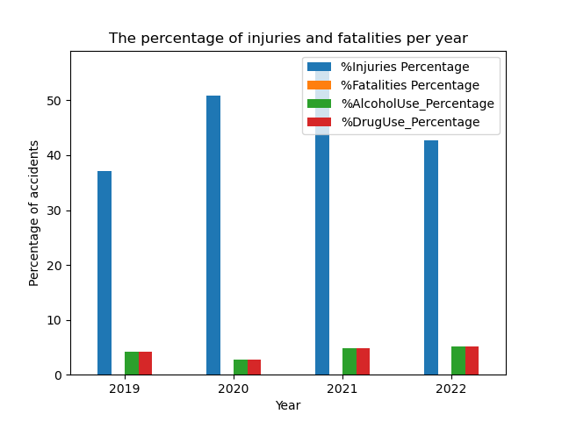
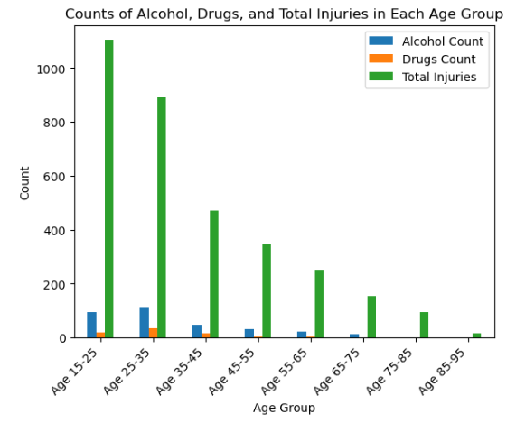
RQ3: Is there an association between age and driving under the influence of alcohol/drugs when accidents occurred in City of Tempe between 2019-2022?

Slide 14
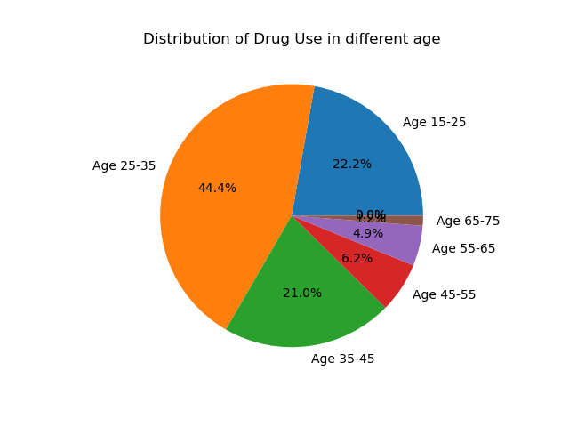
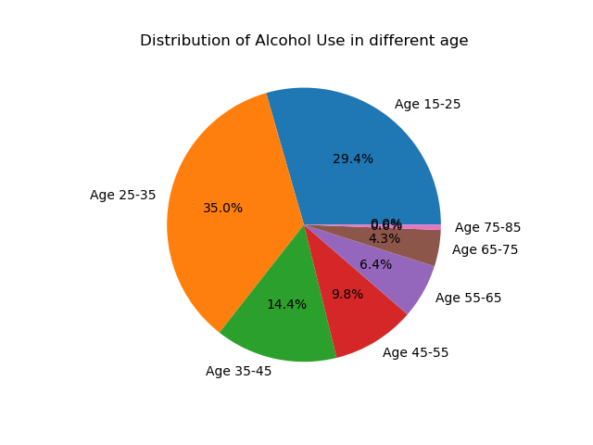
P-value: 0.022, less than 0.05
There is no statistically significant association between Age, Alcohol Use, and Drug Use.

Slide 15
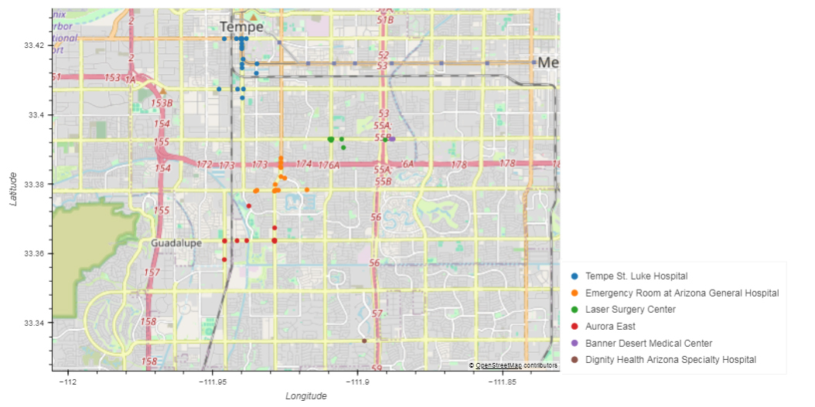
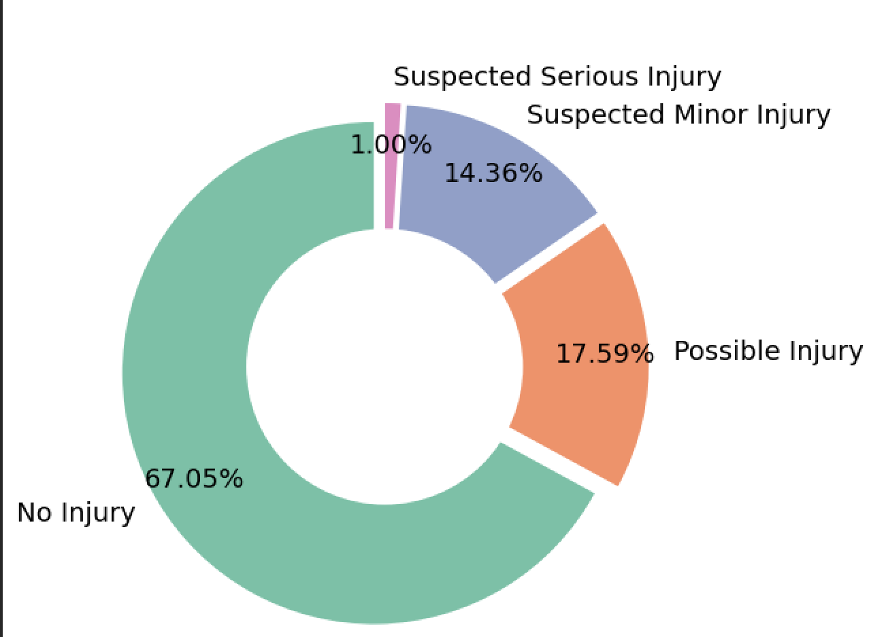
Injury Severity

Slide 16

STATISTICAL ANALYSIS

Slide 17
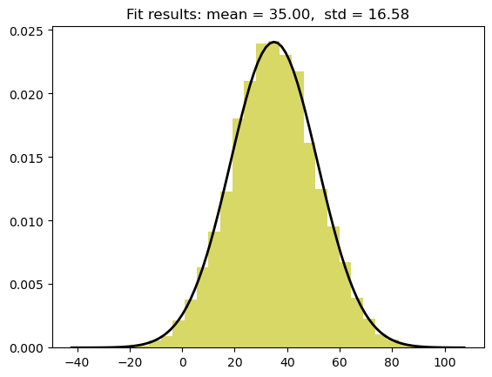
AGE DISTRIBUTION OF DRIVERS
In analyzing the age distribution of drivers in our dataset, we observe a distribution that approximately resembles a bell curve.
Distribution of Ages of Driver 1 and Driver 2 involved in accidents in 2019-2022 in City of Tempe:
Mean = 35 years of age
Std_dev = 16.58
Number of samples = 7590
The symmetry of the curve suggests that the majority of drivers cluster around the average age between 35-36 years of age, with a gradual decrease in frequency as we move away from the mean.
Notes:
The F-statistic is a value you get from the ANOVA test which basically tells you if the variances between your groups are significantly different.
The P-value tells you the statistical significance of your result.
Commonly, a P-value <0.05 is considered significant, meaning that the group means are not statistically significantly different.

Slide 18
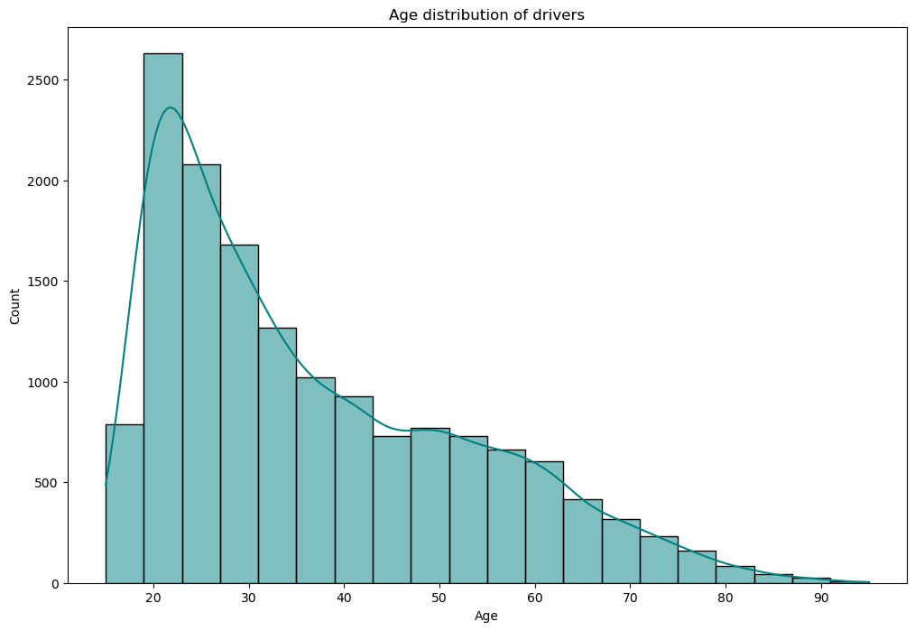
T-test: Comparison of two samples
This visualization serves as an exploratory analysis tool engaging perspective on the age distribution of drivers, contributing valuable insights to the broader analysis of road safety and driver demographics.
Analysis:
t-statistic: 2.1908902300206643
p-value: 0.05983787551928609
Fail to reject the null hypothesis: There is no significant difference.

Slide 19

THANK YOU!

